Slide 1
Identifying Latent Attributes from Video Scenes Using Knowledge Acquired From Large Collections of Text Documents
Anh Xuan Tran
April 30, 2014
Dissertation Committee:
Paul Cohen, Mihai Surdeanu, Kobus Barnard, Ken McAllister
Notes:
Welcome! My dissertation is about “Identifying …”
Now that’s a long title with a lot of words. So let’s find out what it means.

Slide 2
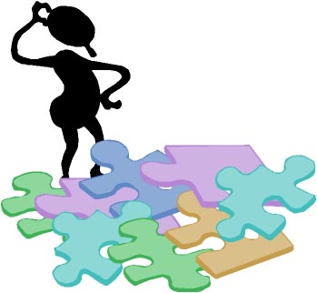




Outline
Defining the Problem
Models
Performance Measures
Results
Conclusions / Future Work
Notes:
First, here’s an outline of my talk.
I’ll start by defining the problem that we worked on. This will hopefully explain the work better than the title did.
-
Then, I’ll present the solutions that we implemented.
-
Next, I’ll talk about how to evaluate the performance of the proposed solution.
-
And then present the actual evaluation results.
-
Last, we’ll draw some final conclusions and discuss possible avenues for future work

Slide 3
Defining the Problem
Models
Performance Measures
Results
Conclusions / Future Work

Slide 4
Motivation
Imagine two young children chasing each other in the playground on a bright sunny day.
Are they enjoying themselves?
Is the child running for his life or is he happy and playful?
It’s a chase! Should someone notify the police?
How were you able to answer these questions?
Needed latent (or hidden) attributes about the scene.
Notes:
We will start with a little thought experiment. I would like everyone here to imagine the following scenario.
-
“Imagine …” Okay now, see if you can answer the following questions.
-
“Are they …”
-
I think most, if not all, of you were able to come up with some reasonable answers to these questions, but how did you do it?
The fact that you can answer these questions means that you must have inferred many things about the scene that were not explicitly stated. Things like the mental states of the children, or their motives, goals, and intentions. We call these types of information, the latent attributes of the scene. Latent because they cannot be directly observed, or extracted from the scene.
-
And we believe it is necessary to know these latent scene attributes in order to fully understand the scene. That is to say, the identification of latent attributes is critically important to video scene understanding.

Slide 5
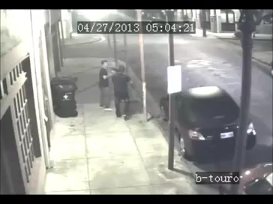
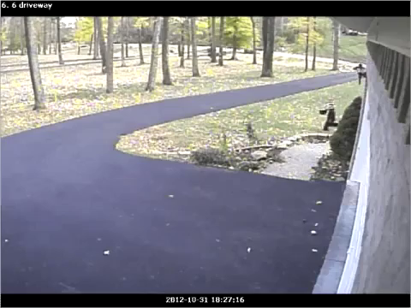
Motivation: Surveillance Application
Should someone notify the police?
A surveillance system could automatically dispatch the police if it can infer that someone is in a state of distress.
Notes:
Take for example, the real-world application of video surveillance.
Here we have two different surveillance videos. And the question is whether or not the police should be notified.
It is easy to see how the identification of latent scene attributes could hugely benefit a surveillance system in this case. If we know that someone is in a state of distress, then clearly the police should be notified.

Slide 6
Problem Definition
Identifying latent attributes from video scenes, with a focus on the mental states of activity participants, given some contextual information about the scenes.
Latent attributes are elements describing a scene that cannot be directly observed or extracted from the scene.
Automatic identification of latent attributes is a challenging task.
Machines do not have access to the same wisdom that humans do.
It only knows what is told, e.g., that there is a chase and it might involve a child.
So how to identify latent information?
Notes:
This leads us to the main problem addressed in this dissertation. The problem is to identify the latent attributes from video scenes given some contextual knowledge about the scene. In particular, we will focus on identifying the mental states of the activity participants
-
Here, we define latent attributes as any elements about the scene that cannot be directly observed or extracted from the scene, such as the mental states, motives, and intentions of the actors.
-
The automatic identification of these latent attributes is not trivial. It is a very challenging task as machines do not have access to the same wisdom that humans do. It doesn’t know the most basic of common sense. It doesn’t know that a smile typically means happy. All a machine knows is what it was told, e.g., that there is a chase happening and it might involve a child.
So how would it go about inferring these latent attributes based on this?

Slide 7
The Approach
Attributes that are latent in visual representation are often explicit in textual representation.
Use explicit visual cues of videos to query large corpora, and from the resulting texts extract attributes that are latent in the videos, such as mental states.
Text Corpora
Information
Extraction
System
Video
Detectors
Detections
Mental States
Notes:
Our approach to the problem is based on one key observation: “Attributes that are latent in visual representation are often explicit in textual representation.”
-
This suggests a novel method for inferring latent attributes: That is use explicit visual cues from the videos, like the detections about objects and activities, as contextual information to query large text corpora; and from the resulting texts extract attributes that are latent in the videos, such as mental states.
The diagram here shows our proposed approach. The gray box outlines the scope of our system. Our system takes detections from a video as input, and then uses information acquired from large text corpora to identify and output the mental states of the participants in the video.
Although we chose to focus on mental states, such as emotional states, I would like to emphasize that the proposed approach would work for any other latent attributes.

Slide 8
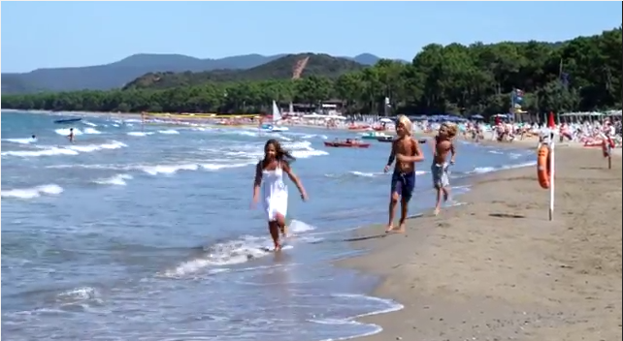
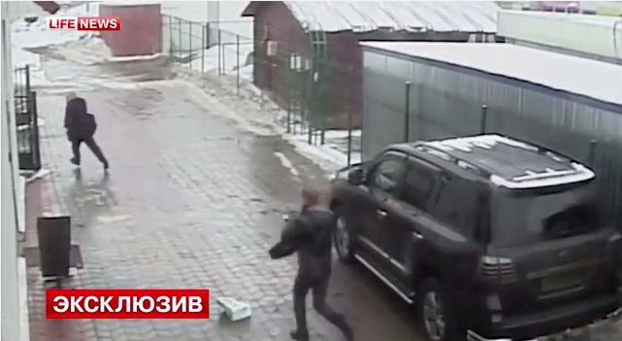
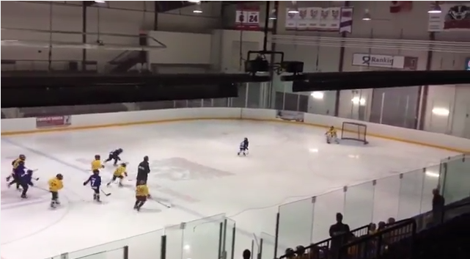
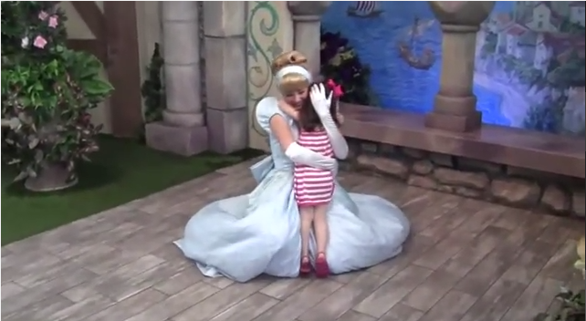
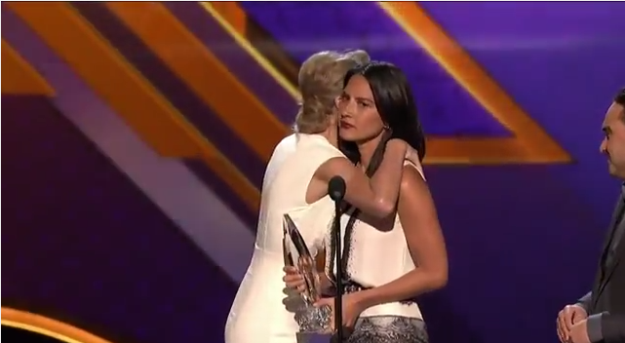
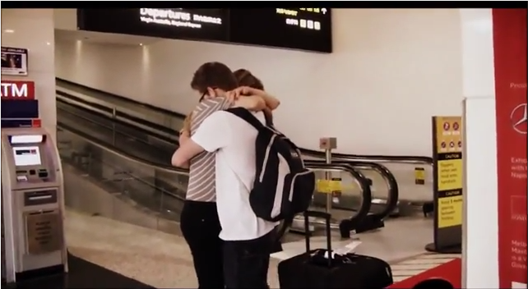
Video Datasets
Generated 2 datasets: chase (26) and hug (45)
Notes:
To test our system, we need videos. We chose to focus on two activities, chase and hug. Chases often invoke clear mental state inferences in humans, which makes it a good test candidate. Hugs are a little more challenging. The difference in mental states between two lovers hugging versus two siblings hugging is much more subtle.
For each verb, we generated a video dataset by finding videos on the Web. We found 26 videos for chase, and 45 different videos for hug.

Slide 9
Video Annotations
Used MTurk to generate ground-truth annotations
Annotate mental states of actors → Use as gold-standard set for evaluation
Ask 10 workers, aggregate results to form frequency distribution
Annotate visual cues – humans as proxy for human-level detection system
Select from predefined list of tags (e.g., policeman, children, walk, run, etc.)
Input into system as contextual knowledge about the scene
Notes:
For each dataset, we used Amazon Mechanical Turk to generate ground-truth annotations for all videos. We showed the video to each MTurk worker and asked them to answer some questions about the video.
-
For each video, we collected the mental state descriptions about each participating actor. We asked 10 different workers to annotate each video and aggregated their answers to create a frequency distribution of mental states for each video. We use this data as the gold-standard sets of mental states for evaluation purposes.
-
Additionally, we also asked the workers to select tags, corresponding to detections, about things that are present in the video. For example, we asked them to identify whether or not a policeman is present or a child. In a sense, we used the MTurk workers as a proxy for an automatic detection system that operates at human-level performance. We then use these detection tags as input to our system.

Slide 10
Video Annotations
Text Corpora
Information
Extraction
System
Video
Detectors
MTurk Workers
Detections
Detection Annotation
Mental State Annotation
?
Mental States
=
Notes:
So again, the context of the system diagram. Here’s what the MTurk workers give us.
--
We also inspected the quality of the
Asides from detections, our system also needs text corpora to query information from.

Slide 11
Text Corpora
English Gigaword 5th edition corpus [primary]
Comprehensive archive of newswire articles
26 GB in size
Contains 9,876,086 documents, over 4B words
Google Web N-gram corpus (1-T)
n-grams up to 5-grams
Generated from 1 trillion word tokens from web pages
Twitter
Collected 200 MB streaming Tweets for 1 month
Mostly irrelevant Tweets, e.g., “why do I keep chasing after bad boys #smh”
World Wide Web [future work]
Hard to access live web – search APIs provide limited queries
ClueWeb09 – 1 billion pages from 2009 – too large for indexing at moment
Notes:
There are many good text corpora available.
The best option that we found is the English Gigaword 5th edition corpus, which is a comprehensive archive of newswire articles. It’s moderately sized at 26GB, which is about perfect for our needs. It is sufficiently large for information extraction, but is small enough to allow for rapid development. We certainly don’t want to wait hours searching through a larger corpus while developing our models. This is the primary corpus that we used.
-
Before settling on the Gigaword corpus, we also examined other corpora. Such as the Google Web N-gram corpus, which is built from 1 trillion word tokens from the web. Unfortunately, it only contains n-grams up to 5-grams; and for our purposes, 5-grams offer too little in context to be useful.
-
We also tried generating a corpus from streaming Tweets using Twitter. After one month of collection, we found out that the information contained in most Tweets are pretty bad (e.g. “why do I keep chasing after bad boys, #smh”).
-
Lastly, the World Wide Web is enticing, but at the moment we don’t have the capabilities to query the entire web. The ClueWeb09 corpus offers an offline version of the web, but at the moment we also don’t have the resources to index 1 billion pages in a timely manner. However, we believe that the ClueWeb09 corpus is still an interesting option, and propose to examine it in the future.

Slide 12
Defining the Problem
Models
Performance Measures
Results
Conclusions / Future Work
Notes:
Now that we have a solid understanding of the problem, as well as the necessary data to work with. It’s time to look at the models.

Slide 13
System Overview
System
Seed Set of Mental State Labels
Information
Extraction
Model
Detections
Query Formatter
Query Tuples
Mental State
Distribution
chase
run
...
child
policeman
person
...
(chase, policeman)
(chase, officer)
(chase, child)
...
P
violent
fearful
energetic
annoyed
sad
...
angry
irate
Notes:
We start with an overview of the proposed system. Given a video, the known contextual information comes into the system as a list of detections, or tags.
These detections are then parsed into tuples of detections by their types – we refer to these as query tuples. Query tuples follow specific typing patterns, such as an (activity, actor-type) pattern. One could use any type of patterns involving any amount of context from the input detections, but we found that our system can perform quite well given just the activity and actor-type.
The important thing that I want to emphasize in this diagram, is the Information Extraction Model box. This is what we will be talking about in the section. I will present several different ways in which we can implement this box. They all differ in implementation. But the most important thing is that they all try to achieve the same thing.
They all take query tuples as input, and output a distribution over mental states. The list of mental states to form a distribution over, is given by a seed set of mental states, and that is what I will talk about next.

Slide 14
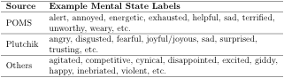
Seed Set of Mental State Labels
Contains 160 mental state labels
Generated from popular dictionaries
Profile of Mood States (POMS) psychological test
Plutchik’s wheel of emotions
Others
Notes:
As I’ve mentioned, asides from the query tuples, our information extraction models also take an initial seed set of 160 mental state labels. This seed set tells the models what mental state labels to search for during the extraction phrase, and ultimately what labels to build a distribution over.
We generated this seed set by taking mental and emotional states from popular dictionaries, such as the Profile of Mood States psychological test, and Plutchik’s wheel of emotions.

Slide 15
Actor Types
Limited set of different actor-type detections:
Inspired by what could reasonably be expected from current state-of-the-art in computer vision. For example:
policeman: An object detector (Felzenszwalb et al. 2008) can be trained to detect the distinctive uniforms of police officers.
child: A child can be distinguished by their height, which can be provided under a 3D tracking model (Brau et al. 2013).
Use synonyms in WordNet to expand set of detections.
policeman → policeman, officer
Notes:
Also, we do limit the set of possible actor types to a small set of detections, all of which could be reasonably expected from the current state-of-the-art technologies in computer vision.
-
Moreover, for each actor-type detection, we use the WordNet dictionary to look for the most frequently used synonyms of that actor type and then adding all found synonyms to our detection set. For example, the policeman tag would generate an additional “officer” tag.
This allows us to expand the set of query tuples for each video.

Slide 16
Neighborhood Models
System
Seed Set of Mental State Labels
Information
Extraction
Model
Detections
Query Formatter
Query Tuples
Mental State
Distribution
Three largely unsupervised information extraction models.
P
violent
fearful
energetic
annoyed
sad
...
angry
irate
Notes:
So again, the input into our information extraction model are: detections are query tuples and a seed set of 160 mental state labels.
The expected output is a response distribution over mental states.
-
I will now discuss 3 different ways for implementing this information extraction model. All of which will output a response distribution over mental states.

Slide 17
Vector Space with Back-off Linear Interpolation
Idea: Project mental state labels and search context into latent conceptual space produced by a RNNLM (Mikolov et al., 2013a).
Compare in latent space using the angle between the vectors.
Recurrent Neural Network Language Model
mad
v_{mad} = [0.4, 0.9, …, 0.8]
angry
v_{angry} = [0.1, 0.6, …, 0.2]
v_{mad}
v_{mad}
v_{angry}
Latent space (2D)
θ
θ
v_{sad}
Notes:
The first model is called the vector model. The main idea is to train a recurrent neural network language model on the Gigaword corpus, and then using the trained network to map words into a 600-dimensional latent vector space.
-
Here’s a simple illustration of what that means. We use the trained network to project mental states like the label mad to the vector (v-mad), where v-mad is a 600-dimentional vector that belongs to some latent vector space generated by this model. Similarly we can map any other word to their corresponding vector representation.
-
We then compare the vector representations of these words in this latent space. The hypothesis is that in this latent space, similar words will project to similar vectors and dissimilar words will project to dissimilar vectors, where similarity is measured as the angle between two vectors. For example, consider a simple 2D space, where words are mapped to 2-dimensional vectors. Then we would expect the angle between the vectors for mad and angry to be small, while the angle between mad and sad should be much bigger.

Slide 18
Vector Space with Back-off Linear Interpolation
Idea: Project mental state labels and search context into latent conceptual space produced by a RNNLM (Mikolov et al., 2013a).
Compare mental state labels to query tuple in latent space.
Recurrent Neural Network Language Model
mad
v_{mad} = [0.4, 0.9, …, 0.8]
angry
v_{angry} = [0.1, 0.6, …, 0.2]
v_{(chase, policeman)}
v_{(chase, policeman)}
v_{angry}
Latent space (2D)
θ
θ
v_{sad}
Notes:
We can apply the same general idea to our problem.
Suppose now instead of the vmad vector, we have a context-vector that represents our query tuple. Clearly, there are some mental state labels are closer to this context-vector in this latent space. We can compute the similarity between this context-vector to each of the mental state label in our seed set, and generate a distribution over mental state labels based on these scores.

Slide 19
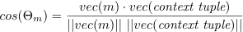
Vector Space with Back-off Linear Interpolation
Compute context-vector for query tuple:
Compute similarity to each mental state m:
→ 160 scores per context (or query) tuple.
Normalize scores to generate a distribution per tuple, average across tuples to create one distribution, and prune to yield final response distribution.
v_{(chase, policeman)}
v_{m}
θ
Notes:
To compute a context-vector for a query tuple, we simply aggregate the vectors of the search terms.
For example, the context vector for the tuple (chase, policeman) is simple the sum of the chase vector and the policeman vector.
-
We compute the similarity between the context-vector to each mental state label m from the seed set using the cosine similarity.
-
This generates 160 different similarity scores, one per mental state from our seed set. By normalizing this list of sores, we come up with a single distribution of mental states for each query tuple. We simply average across all query tuples to come up with one distribution for the video.
Lastly, we prune this distribution by taking the top elements that make up some percentage of the total distribution weight, and this becomes the output response distribution.

Slide 20
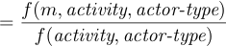
Sentence Co-occurrence with Deleted Interpolation
Idea: Words in the same sentence are likely to be related.
Rank mental state labels based on the likelihood that they appear in sentences cued by query tuples.
Interested in the conditional probability:
Normally, we could compute this probability based on relative frequencies.
However, estimation is unreliable due to sparse data!
Notes:
Our 2nd model is the sentence co-occurrence model. The idea is simple: Words in the same sentence are likely to be related.
So we would like to rank mental state labels based on the likelihood that they appear in sentences cued by query tuples.
-
That is we are interested in the conditional probability that a mental state label m would occur in a sentence, given that we already observed the desired activity and actor-type in the same sentence. Where the activity and actor-type are given by a query tuple.
-
Now normally, we can compute this probability directly using the relative frequencies from the data. For example, f(activity, actor-type) would count the number of sentences in the corpus that contain both terms. Furthermore, we imposed a part-of-speech restriction. That is the activity must occur as a verb, and the actor-type as a noun.
-
Unfortunately, it’s not that simple, as these frequencies are very unreliable.

Slide 21
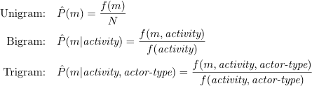
Sentence Co-occurrence with Deleted Interpolation
Cannot estimate probability of trigrams reliably from the corpus, so we estimate probability as linear interpolation of unigrams, bigrams, trigrams.
Define maximum likelihood probabilities based on relative frequencies:
N = total number of tokens in the corpus
f(m, activity) = number of sentences containing both m as an adjective and activity as a verb
Use deleted interpolation to estimate lambdas.
160 trigram probabilities for each query tuple, average across all query tuples and prune to yield final response distribution.
Notes:
So instead, we estimate the probability as a linear interpolation of unigrams, bigrams, and trigrams.
Using this method allows us to reliably estimate the desired conditional probability.
This method gives us 160 different trigram probabilities for each query tuple, one for each mental state label in the seed set. Once again, we use these probabilities as scores, and normalize the scores to create one distribution of mental states per query tuple. We then average across all input query tuples and prune to yield a final response distribution.

Slide 22
Event-centric with Deleted Interpolation
Idea: Identify the event + its participants in the relevant sentences and focus only on the mental states of event participants.
A smarter, more robust, way to find collocating mental states for joint frequency estimation.
Go beyond sentence boundary.
Focus on mental states of participants.
Notes:
Our third and final model improves over the previous sentence model, by providing a smarter, more robust way to find collocating mental state labels for joint frequency estimation. We call it the event-centric model.
In particular, it addresses two limitations of the sentence model.
First, it goes beyond the single sentence boundary. We found that restricting ourselves to a single sentence was too limiting. We frequently saw joint frequency counts of 0.
Secondly, the sentence model was perhaps too lenient with its mental state extraction. It counted any mental state label that falls within the neighborhood area, regardless of who that mental state label references. We would like to be smarter and more selective, by focusing only on the mental state labels of event participants.
We do so by following 3 main steps.

Slide 23
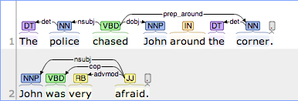
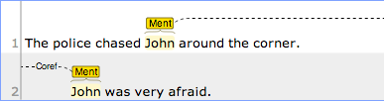
Event-centric Model
Example Output
Step 1: Participants Identification
Participants
Step 2: Corefence Resolution
Corefence Chains
Step 3:
Mental State Extraction
Mental States
Notes:
The first step in the algorithm is to identify the event and its participants from text. We do this by first identifying all sentences in the corpus where the event, for example chase, appears as a verb. Then for each verb, we use the syntactic dependency structure of the sentence to identify the nominal subject and the direct object of the verb. In this simple example, we can follow the nsubj and dobj relations to identify that the police is the subject of the verb, and John is the direct object, or the person being chased.
Once the phrases referring to the participants of interest have been found in the target sentence, we seek all other mentions of these participants by traversing the coreference chains containing the phrases extracted from step 1.
The last step extracts mental state complements from sentences in the neighborhoods that reference the participants of interest. We again do so by exploring the syntactic dependency structure of the sentence. In general, we look for patterns involving several copula verbs: such as to be and feel. In this example, … Indeed afraid is also an adjective, and a mental state, so we increment the frequency count for the bigram (chase, afraid), and also the trigram (chase, policeman, afraid).
As with the sentence model, once the relative joint frequencies are computed we can estimate the desired conditional probability scores. We then follow the same strategy as before to combine the conditional probability scores into a single response distribution output.

Slide 24
Defining the Problem
Models
Performance Measures
Results
Conclusions / Future Work
Notes:
So that’s our models. Let’s now shift gear to talk about how one might evaluate the performance of those models.

Slide 25
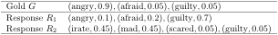
Evaluation
New task → No standard performance measure
Compare two normalized distributions over mental states.
Similarity of distribution shapes
A good measure must account for the similarity between the shapes of the two distributions (i.e., ratios between weights)
Semantic similarity of distribution elements
A good measure must allow for semantic comparisons at the level of distribution elements (i.e., recognize that irate and angry are similar)
Notes:
As far as we know, the task we propose here is novel. As such, there is really no precedent work, and as a consequence, no standard evaluation model for the task. So part of our research is to seek a good performance measure for the problem.
-
The primary evaluation task is to compare two mental state distributions. It is not a trivial task, as a good performance measure must account for 2 things.
-
The first thing it must account for is the similarity between the shapes of the distributions.
-
The second thing it must account for is the semantic similarity of distribution elements.
-
For instance, let’s look at a toy example. Here is a gold distribution G, and 2 different response distributions to be matched against G. Clearly we can see that R1 matches the terms in G perfectly, however it matches the shape of G poorly. That is R1 heavily favors guilty when it should have favored angry. R2 on the other hand doesn’t have an exact match for all of its terms, but does match the full meaning and shape of G, since irate and mad are similar to angry, and scared is the same as afraid.

Slide 26
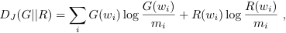
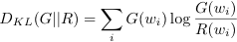
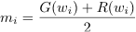
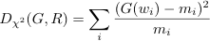
Known Distribution Similarity Measures
Many known methods for comparing distributions (Rubner 2000)
Kullback-Leibler divergence
Jeffrey divergence
χ² statistics
Earth Mover’s Distance (EMD)
Given two collections of dirt piles, EMD measures the least amount of work needed to rearrange the dirt piles of one collection to match the other.
Provide different costs for moving a unit of dirt between different piles.
Finds optimal solution in super-cubic time.
Notes:
There are currently many known methods for comparing 2 different distributions
-
Such as the KL-divergence and the chi square statistics. These distance measures all have their advantages, but the bottom line is: They don’t account for comparison of similarity at the level of distribution elements.
-
However, the Earth Mover’s Distance, popular in computer vision, does. Intuitively, given two collections of dirt piles, EMD measures the least amount of work needed to rearrange the dirt piles of one collection to match the other. It allows for different costs of moving a unit of dirt between different piles. There are a few subtle reasons why EMD does not quite fit our needs, which I won’t go into for this talk. The biggest drawback of EMD is its super-cubic runtime in the size of the distributions, which can be a problem as our response distributions can be large.
So while EMD does satisfy both criteria, we seek a more intuitive and less computationally expensive measure.

Slide 27
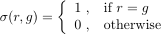
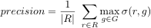
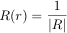
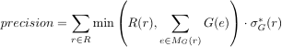
Constrained Weighted Similarity-Aligned F1
We start with the standard F₁ measure.
Generalize the formulas to address our criteria.
Address greedy problem of WSA-F₁
F₁
SA-F₁
WSA-F₁
CWSA-F₁
Notes:
Our research eventually led to the construction of a new performance measure, based on the simple and intuitive F1 measure. The standard F1 measure is defined as the harmonic mean between precision and recall. F1 does not immediately address any of our criteria so some modifications are needed. We do this by generalizing the formulas as follows.
-
The calculation of precision, which is simply the number of true positives over the size of the response set, can be generalized to the following equation. Note that the calculation of true positives is the same as comparing each element in the response set R to every element in the gold set and then returning the best (or max) match score, where the matching function is defined to return 1 for an exact match…
Clearly, this similarity function sigma can instead be defined to take on values proportional to the semantic similarity between labels r and g. This allows us to choose from a wide range of word similarity …We can similarly define recall, and also an F1 value as the harmonic mean of these new scores. We call this first formulation the Similarity-Aligned F1 score, as it accounts for the similarity between words. But it does not account for their weights.
-
Let’s generalize the equation some more by moving the division into the summation. If we define the function R to return the uniform probability 1 / |R| for all elements r in the response set, then this is the exact same equation as above. In this formulation, it is clear to see that every element is assigned a uniform weight in the standard F1. Clearly, we can simply use the distribution weight of r instead of this uniform weight. We also define this value delta * to represent the max term above. This gives us our Weighted Similarity-Aligned F1 score.
-
It would seem on the surface that WSA-F1 addresses both criteria of our problem. However, there is a flaw in that it does not account for the total weights available for rewards in the other distribution. We address this issue with the constrained weighted similarity-aligned F1 score.

Slide 28
Constrained Weighted Similarity-Aligned F1
We start with the standard F₁ measure.
Generalize the formulas to address our criteria.
Address greedy problem of WSA-F₁
F₁
?
SA-F₁
WSA-F₁
CWSA-F₁
Notes:
A simple analogy might help here, suppose we have a mystery box of color pencils that we try to match.
-
Suppose that our response box contains 10 red color pencils.
-
But the mystery box only contains only 2 red color pencils.
-
Should we be rewarded for all 10 red pencils?
-
Or should the reward be capped by the 2 red pencils available in the mystery box.
We believe the latter is more accurate.
We address this issue by adding a min term, to cap the amount of reward an element can receive. To better explain this, let’s look at our toy example from before.

Slide 29
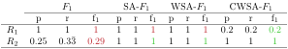
Constrained Weighted Similarity-Aligned F1
Suppose that σ(angry, irate) = σ(angry, mad) = σ(afraid, scared) = 1,
with σ of any two identical labels being 1, and σ of all other pairs are 0.
red = non-intuitive score
green = intuitive score
Notes:
In this example, remember that R1 does not match the shape of G, while R2 matches the shape and the meaning of G.
-
Here are the scores for R1 and R2 under the classical F1 measure. Remember that the standard F1 does not account for synonyms, or weights. So it fully rewarded R1 for having exact string matches, and severely punished R2 for using synonyms. Both of these scores are not very intuitive with the expected behavior.
-
Similarity-Aligned F1 accounts for synonyms, and hence rewarded R2, which is intuitively correct. It still gave R1 a high score, though, since it does not care about weights.
-
Now, Weighted Similarity-Aligned F1 is suppose to take into account distribution weights, but it still gave a high score to R1. Why? This is the problem I mentioned. Let’s dissect this a bit. For precision, the element guilty in R1 has an exact match in G, so the measure gives full credit to guilty, which means guilty is rewarded the full 0.7 amount, even though there’s only 0.05 available in the gold set. As for recall, angry from the gold set received the full 90% reward for recalling angry, when there’s only 10% of it in R1.
-
CWSA-F1 fixes that. For precision it limits the amount of rewards of guilty to the min between guilty, and the accumulated mass of all terms in the gold set that best match to guilty. So in this case, the guilty element from R1 is only rewarded 0.05 of its 0.7 value. For the recall of R2, the reward for recalling angry is limited by the accumulated mass between irate & mad in R2, which also happens to be 0.9, so angry is rewarded for the full 0.9 on recall. We see here that CWSA-F1 is the only score to give the most intuitive results.
On a final note, I’d like to mention that CWSA-F1 is quadratic in the size of the distributions. We don’t think it is possible to do any better, because at the minimum, one must compare each element of one distribution to every element in the other distribution.

Slide 30
Defining the Problem
Models
Performance Measures
Results
Conclusions / Future Work
Notes:
Now that we have a way to measure performance, let’s look at some performance results. Before we begin, I’d like to mention that we only provide a summary of the results found in our experiments. You can refer to my dissertation for more thorough analyses of the experiments.

Slide 31
Evaluation Procedure
Video
Evaluation
Protocol
Give video detections to system
Show video to MTurk workers
How well does R match G ?
Generate response distribution R
Generate ground-truth distribution G
Compute similarity between R & G
Similarity score
Notes:
The evaluation procedure is as follows:
Given a video, we show it to MTurk workers and generate a ground-truth distribution G. We then give the detections of the same video to our system and generate a response distribution R.
-
The experimental question is then: How well does R match G?

Slide 32
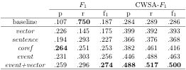
Mental State Identification in Chase Videos
The average evaluation performance across 26 different chase videos are shown against the baseline scores for our neighborhood information extraction models. Bold font indicates the best score in a given column.
* All average improvements over the baseline responses are significant (p < 0.01). All significance tests were one-tailed and were based on nonparametric bootstrap resampling with 10,000 iterations.
Notes:
And here is the performance results averaged across 26 different chase videos for each model.
We compare these scores against a baseline model. The baseline model is a naïve model that simply returns all 160 mental states from our initial seed set with uniform probability.
Again, we have the three familiar models: vector, sentence and event model. The coref model, is the same as the event model minus the 3rd step in the algorithm.
That is, it only uses coreference resolution to expand the neighborhood area, but it does not take that final step to use extra syntactic dependency relations to focus on the mental states of event participants. Instead, it counts any mental state labels that occur within the neighborhood area, similar to the sentence model.

Slide 33
Mental State Identification in Chase Videos
event+vector outperformed baseline by almost 75%.
Ensemble outperformed individual components.
Operating in latent space (vector) and operating on text (event) yield complementary information.
Incremental improvements due to NLP.
sentence < coref < event
Notes:
Under the CWSA-F1 performance measure, which does correctly account for both synonyms and distribution weights. The ensemble model event+vector scored best in all measured scores. It improves over the naïve baseline by almost 75%!
-
Moreover, it outperformed each of its individual component by a significant amount. We found this to be true when combining any deleted interpolation model with the vector model. This strongly suggests that the information gained by operating in a latent conceptual space, and operating on text are highly complementary.
-
We also noticed a steady improvement in performance as we added more NLP techniques to focus in on the mental state of event participants. The coref model, which added coreference resolution to expand the neighborhood outperformed the sentence model, and then the event model which adds syntactic dependency patterns on top of the coref model to focus on participants did even better. This shows that the use of NLP techniques can help improve information extraction performance.

Slide 34
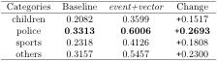
Limitation: Biases in Underlying Data
The average CWSA-F₁ scores for the ensemble model event+vector are shown in comparison to the baseline performance, categorized by video scenarios.
children = video contains a child participant
police = video contains a policeman participant
sports = video is sports-related
other = video does not fit in the first categories (e.g., civilian adults)
Notes:
It turns out that our models did not do equally well across all videos. There are videos for which we did very well on, and there are ones that are more challenging to our models.
Here, we list the average CWSA-F1 scores for the ensemble model event+vector and the baseline model, categorized by different video scenarios. The children category includes any chase videos involving a child participant; likewise for the police category; the sports category includes any sports-related videos. All other videos fall into the others category, such as videos involving normal civilian adults. Note that a video my fall into multiple categories. For example we have 2 videos of children playing sports.
*** Of these, five involve police officers, seven involve children, four show sports-related scenes, and twelve describe different chase scenarios involving civilian adults (two videos involve both children and sports scenes).

Slide 35
Limitations: Biases in Underlying Data
Baseline did worse on children and sports-related videos than police related videos.
Baseline uses all 160 mental states with uniform probability.
Initial seed set is more fit to describe police chases.
See biggest improvement over baseline on police videos, least improvement on children videos.
Gigaword corpus = newswire articles
Underlying corpus is biased towards police chases (i.e., news-worthy events).
Notes:
We noticed a few interesting trends here. The baseline method did worse on children and sports-related videos than on police related videos.
-
But remember that the baseline doesn’t do any thing smart, it simply returns all 160 mental states from our set with uniform probability. This means that our initial seed set of mental states is more fit to describe police chases than other chases. So it is biased towards police videos.
-
Moreover, we also see that the ensemble model makes the biggest improvement over the baseline method on police videos (both in terms of raw value and percentage), and makes the least improvement on children videos.
-
We think this is evidence of the information bias from the Gigaword corpus. Recall that the Gigaword corpus comprises of newswire articles, and news usually contain a very specific type of information. In particular, the news is more likely to address news-worthy events like police chases, and even sports events. It is not the place to find descriptions of happy children chases. So again, the bias in the underlying data source favors police videos.

Slide 36
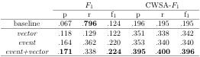
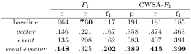
Actor-specific Mental State Identification
The average evaluation performance for the mental state of the
subject across 26 different chase videos.
The average evaluation performance for the mental state of the
object across 26 different chase videos.
Notes:
Our previous experiments have focused on the activity-wide mental state identification task. That is, we return a single distribution of mental states to describe the entire activity. However, our event model is capable of differentiating between the mental states of the subject versus the object. This allows us to solve the actor-specific mental state identification task. In general, this is a harder task as it requires more specific information.
-
Here are the results averaged across 26 videos for the subject (i.e., the chaser). We see that overall the scores are a little lower, since the task is harder. The added difficulty of the task is also evidence in the much lower performance of the baseline.
-
Similarly, here are the results for the object, or the person being chased. In both cases, our ensemble model performed best and significantly improved over the baseline by over 100%.
This shows that our system is definitely capable of making actor-specific mental state identification.

Slide 37
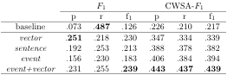
Mental State Identification in Hug Videos
The average evaluation performance across 45 different hug videos are shown against the baseline scores for our neighborhood information extraction models. Bold font indicates the best score in a given column.
Notes:
Lastly, we move on to the hug dataset. Here are the results averaged across 45 different hug videos.

Slide 38
Mental State Identification in Hug Videos
Overall lower performance
Data bias, only 41K documents containing hug vs. 141K documents for chase
event+vector outperformed baseline by over 100%
Consistent behavior as seen in chase videos:
Ensemble outperformed individual components.
Incremental improvement with each NLP module.
Notes:
The first thing we noticed is that performance is lower overall. Does this mean that hug videos are harder?
Potentially, we think that this also has to do with the data bias in the Gigaword corpus. In general, just like stories about children chases, stories about hugs are not very news-worthy. In fact, there are only 41K different documents in the corpus that contain the word “hug”, where as for chase, there are 141K documents from the corpus containing the word “chase”.
-
Despite the extra bias in the data, the ensemble model still outperformed the baseline by over 100%.
-
Moreover, the behavior of our system was very consistent with what happened in the chase dataset. All of the previous trends still hold.
The ensemble model still did best overall, and still outperformed each of its individual component by a good margin.
The addition of NLP components still improved performance over the shallower sentence model.
All of these results show that our models are general works consistently well across different events.

Slide 39
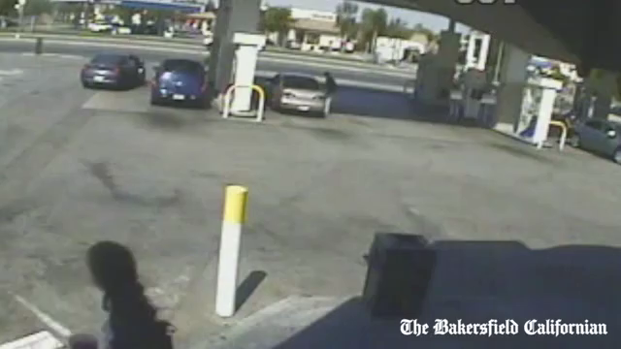
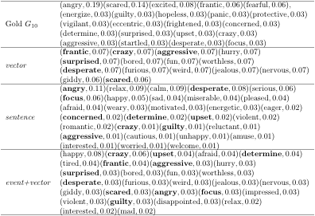
chase10
Notes:
Just to give everyone a peek at what an output from our system looks like. Here is an example output for the 10th chase video in our dataset.
Each distribution is represented as a list of elements and their associated weights. The gold standard distribution G10 is generated by aggregating mental state annotations from 10 different MTurk workers.
Each row is a particular model and its response distribution.
Bold font in a response distribution indicates an exact match with an element from G10 .
Notice that our system often uses synonyms. For example, the event+vector model also uses furious and mad, but only got credit for angry and upset.

Slide 40
Defining the Problem
Models
Performance Measures
Results
Conclusions / Future Work
Notes:
We’ve now reached the last section of the talk.

Slide 41
Conclusions
Summary
Problem: Identifying latent attributes in videos, given some context.
Data: Videos from web, annotations via crowd sourcing
Solution: Largely unsupervised information extraction models
Lexical semantic in vector space (vector)
Sentence co-occurrence in text (sentence)
Event-centric in text (event)
Evaluation: CWSA-F₁ score to compare mental state distributions
Findings
Little context needed (activity, actor-type)
Ensemble models perform best
NLP techniques help
Actor-specific identification is possible
Works for different events (e.g., chase and hug)
Notes:
-
In this talk, I’ve introduced the problem of identifying latent attributes in videos, given some contextual information about the video.
-
I’ve described how we generated the data,
-
And presented 3 largely unsupervised information extraction models for acquiring information about latent attributes from large corpora.
We looked at a lexical semantic model that operates in a latent conceptual space, a sentence co-occurrence model, and a more sophisticated event-centric model.
-
We also talked about how to evaluate these models. In particular, we constructed a novel performance measure based on the classical F1 measure that accounts for both the similarity in the shapes of the distributions, and the semantic similarity between their elements.
-
Through the development and evaluation of our models, we discovered some interesting findings.
We showed that little context is needed to get good results, which means our system would only need a few robust detectors to work well.
-
We found that information gained from working on text, and from operating in a latent vector space are highly complementary.
-
And the inclusion of NLP components can help improve our performance.
-
Also, we can do actor-specific mental state identification,
-
And our system is general enough to work for different events.

Slide 42
Future Work
Model Improvement
Resolve data bias – Use ClueWeb09 corpus (contains 1 billion web pages)
Automatically learn new mental state labels & extraction patterns
Mutual bootstrapping (Riloff and Jones, 1999)
More contextual information? Increase size of input query tuples.
Computer Vision Integration
Degrade quality of MTurk annotations to simulate noisy detectors
Integrate full automatic detection system
Other Applications
Apply the CWSA-F1 score to other problems (e.g., image retrieval)
More challenging (ambiguous) verbs: walk and run
Medical diagnosis – identify causes relating to known context symptoms.
Notes:
I think there are many exciting avenues for future work.
The first line of research is to improve the models.
-
We can swap in a different corpus to see how big an effect the underlying data source has on performance.
-
Currently we restrict our models to a seed set of 160 mental state labels, one could potentially expand this set by learning new mental state labels, as well as new extraction patterns simultaneously, using a mutual bootstrapping approach.
-
Another interesting avenue is to test the effect of the amount of context on performance. We could try many different query patterns. Does performance always increase with more context? From a machine learning perspective, one could potentially learn which type of detections are most informative.
Another avenue is to integrate actual detection algorithms.
-
Though, the integration of a fully functional detection system is a daunting task. As a first step, we could just degrade the quality of MTurk annotations to simulate noisy detectors and see how well our models perform with noisy input.
-
Then we can try actually integrating a functional detection system.
Lastly, we can explore other applications.
-
We can apply the CWSA-F1 score to other problems, such as image retrieval. Images are often represented as histograms of data (e.g., gray-scale intensities). We can use the score to compare images, and retrieve the most similar image from a bank of images.
-
We can try more challenging (that is more ambiguous) verbs, such as run and walk.
-
Lastly, one can potentially apply this approach to problems of other domains, such as medical diagnosis. For example, given a list of known symptoms as context, we could query specialized medical texts to find relevant causes.

Slide 43
Acknowledgements
I would like to express my heartfelt gratitude to the following people for helping me realize my dream (in no particular order).
My advisors.
My committee.
My colleagues and friends.
Most important of all, my family!

Slide 44
The End

Slide 45
Related Work
Mental State Inference
Typically formulate as a classification problem
Use low level sensory input to predict mental state labels
Typically modeled using HMMs and DBNs
Abbasi et al., 2009; Teoh and Cho, 2011; El Kaliouby and Robinson, 2004; Baltrusaitis et al., 2011
Computer Vision
Wide arrays of object detectors
Felzenszwalb et al. 2008; Yang and Ramanan 2011, Ramanan 2012
Trackers 2D (Ramanan et al. 2007) and 3D (Brau et al. 2011)
Human action recognitions (O’Hara and Draper 2012; Sadanand and Corso 2012)
Natural Language Processing & Information Extraction/Retrieval
Many text processing tools: POS tagging, syntactic dependency, named entity recognition, coreference resolution, semantic role labeling.
Many novel unsupervised information extraction solutions
Identifying meaning of “little kid” (Marneffe et al. 2010); infer yes/no answers from indirect yes/no answers (Mohtarami et al. 2011); extract narrative schemas and information templates from text (Chambers and Jurafsky, 2009, 2011)
Notes:
Mental state interference is a well-established problem in the AI field.
-
It is often formulated as a classification problem, where the goal is to build a classifier to predict target mental state labels based on low-level sensory input. Most popular solutions tend to use HMMs and DBNs as these representations can naturally model the ever-changing nature of human emotions. The solutions listed here tried to predict the emotional states of humans, such as students, based on their unintentional body gestures. Some can even do it in real-time.
-
Computer vision is a matured area of research. It offers numerous tools and techniques for detecting objects and activities in videos. These algorithms perform quite well, considering the difficulty nature of their problem. Although, they are far from achieving human-level performance. The field is progressing rapidly.
-
Like computer vision, NLP offers many tools for parsing text Though they’re often error-proned, they do perform well enough to support information extraction. Some interesting unsupervised information extraction solutions relevant to our work include Marneffe et al, Mohtarami et al, and Chambers and Jurafsky.

Slide 46
References
Abbasi, Abdul Rehman et al. “Student Mental State Inference from Unintentional Body Gestures Using Dynamic Bayesian Networks.” Journal on Multimodal User Interfaces 3.1-2 (2009): 21–31. Web. 23 Jan. 2014.
Baltrusaitis, Tadas et al. “Real-Time Inference of Mental States from Facial Expressions and Upper Body Gestures.” Face and Gesture 2011. IEEE, 2011. 909–914. Web. 23 Jan. 2014.
Brau, Ernesto et al. “A Generative Statistical Model for Tracking Multiple Smooth Trajectories.” CVPR 2011. IEEE, 2011. 1137–1144. Web. 23 Jan. 2014.
Chambers, Nathanael, and Dan Jurafsky. “Template-Based Information Extraction without the Templates.” Proceedings of the 49th Annual Meeting of the Association for Computational Linguistics: Human Language Technologies - Volume 1. N. p., 2011. 976–986. Web. 12 Apr. 2013.
Chambers, Nathanael, and Dan Jurafsky. “Unsupervised Learning of Narrative Schemas and Their Participants.” Proceedings of the Joint Conference of the 47th Annual Meeting of the ACL and the 4th International Joint Conference on Natural Language Processing of the AFNLP Volume 2 ACLIJCNLP 09. N. p., 2009. 602–610. Web. 11 Apr. 2013.
El Kaliouby, R., and P. Robinson. “Real-Time Inference of Complex Mental States from Facial Expressions and Head Gestures.” 2004 Conference on Computer Vision and Pattern Recognition Workshop. IEEE, 2004. 154–154. Web. 23 Jan. 2014.
Felzenszwalb, Pedro, David McAllester, and Deva Ramanan. “A Discriminatively Trained, Multiscale, Deformable Part Model.” 2008 IEEE Conference on Computer Vision and Pattern Recognition. IEEE, 2008. 1–8. Web. 23 Jan. 2014.
Marneffe, MC De, CD Manning, and Christopher Potts. “‘Was It Good? It Was Provocative.’ Learning the Meaning of Scalar Adjectives.” Proceedings of the 48th Annual Meeting of the Association for Computational Linguistics. N. p., 2010. 167–176. Web. 15 Apr. 2013.
Mikolov, Tomas et al. “Efficient Estimation of Word Representations in Vector Space.” arXiv preprint arXiv:1301.3781 (2013): 1–12. Web. 26 Aug. 2013.
Mohtarami, Mitra et al. “Predicting the Uncertainty of Sentiment Adjectives in Indirect Answers.” Proceedings of the 20th ACM International Conference on Information and Knowledge Management - CIKM ’11. New York, New York, USA: ACM Press, 2011. 2485. Web. 23 Jan. 2014.
O’Hara, S, and B. A. Draper. “Scalable Action Recognition with a Subspace Forest.” 2012 IEEE Conference on Computer Vision and Pattern Recognition. IEEE, 2012. 1210–1217. Web. 23 Jan. 2014.
Ramanan, D. “Face Detection, Pose Estimation, and Landmark Localization in the Wild.” 2012 IEEE Conference on Computer Vision and Pattern Recognition. IEEE, 2012. 2879–2886. Web. 23 Jan. 2014.
Ramanan, Deva, David a Forsyth, and Andrew Zisserman. “Tracking People by Learning Their Appearance.” IEEE transactions on pattern analysis and machine intelligence 29.1 (2007): 65–81. Web. 23 Jan. 2014.
Riloff, E, and R Jones. “Learning Dictionaries for Information Extraction by Multi-Level Bootstrapping.” Proceedings of the Sixteenth National Conference on Artificial Intelligence (AAAI-1999). N. p., 1999. 474–479. Web. 15 July 2013.
Rubner, Yossi, Carlo Tomasi, and LJ Guibas. “The Earth Mover’s Distance as a Metric for Image Retrieval.” International Journal of Computer Vision 40.2 (2000): 99–121. Web. 26 Apr. 2014.
Sadanand, S., and J. J. Corso. “Action Bank: A High-Level Representation of Activity in Video.” 2012 IEEE Conference on Computer Vision and Pattern Recognition. IEEE, 2012. 1234–1241. Web. 23 Jan. 2014.
Teoh, Teik-Toe, and Siu-Yeung Cho. “Human Emotional States Modeling by Hidden Markov Model.” 2011 Seventh International Conference on Natural Computation. IEEE, 2011. 908–912. Web. 23 Jan. 2014.
Yang, Yi, and Deva Ramanan. “Articulated Pose Estimation with Flexible Mixtures-of-Parts.” CVPR 2011. IEEE, 2011. 1385–1392. Web. 23 Jan. 2014.

Slide 47
Backup Slides

Slide 48
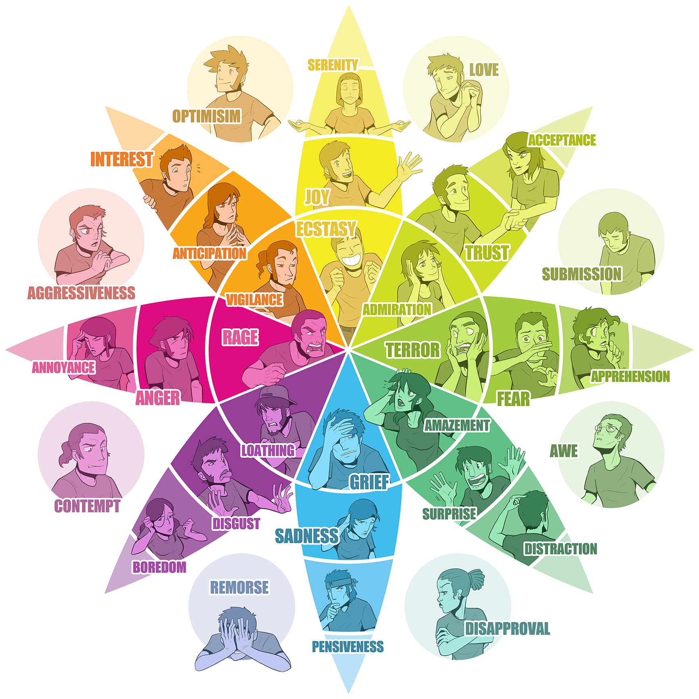
Source: CopyPress
Notes:
Plutchik’s wheel of emotions

Slide 49
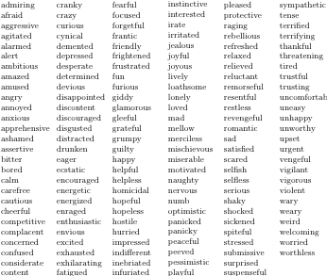
Notes:
List of 160 mental state compiled from popular mental and emotional state dictionaries, including the Profile of Mood States (McNair et al., 1971) and Plutchik’s wheel of emotions. These labels also include frequently used labels gathered from synsets found in WordNet.

Slide 50
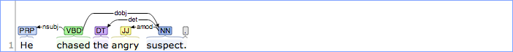
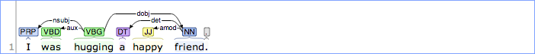
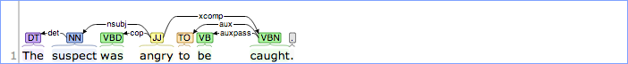
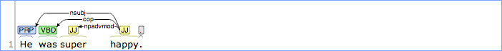
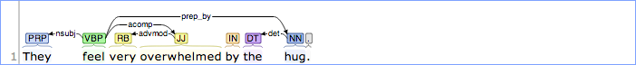
Notes:
Complements extraction patterns
- amod from subject
- nsubj + cop
- nsubj + aux
- nsbuj + acomp
- nsubj + dep

Slide 51
Notes:
Participants identification patterns
- nsubj + dobj
- dobj
- nsubjpass + agent (by)
- nsubj + prep_after (after for chase)

Slide 52
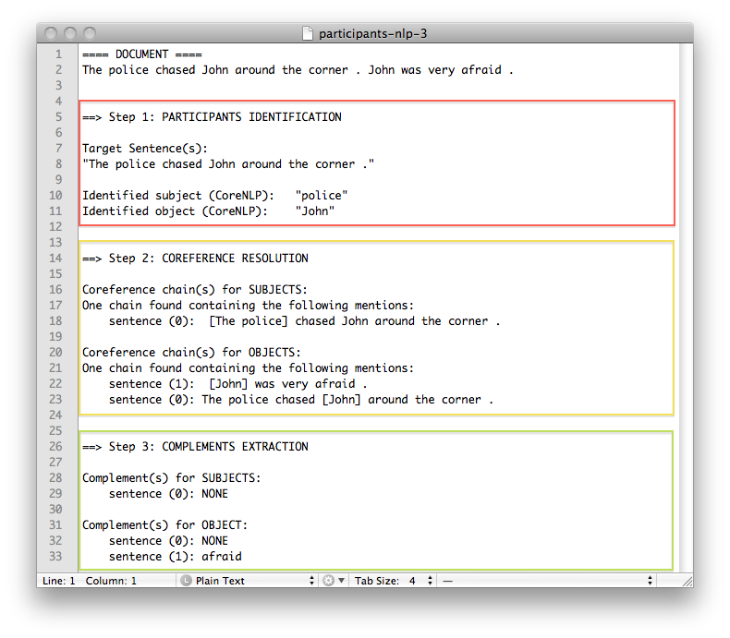
Notes:
That was a mock-up example. Here’s an actual output from our model on the same sentences.
We see that step 1 correctly identified the participants of chase.
Step 2 found the correct coreference chain for John.
And Step 3 identified the mental state complement afraid for the object John.

Slide 53
Document: [ A . B . C . D . E . F . G . H . I . J ]
Models:
Neighborhoods:
sentence
A . B . C . D . E . F . G . H . I . J
{B} ; {D} ; {H}
win-0
A . B . C . D . E . F . G . H . I . J
{B, D, H}
win-1
A . B . C . D . E . F . G . H . I . J
{A, B, C, D, E, G, H, I}
win-2
A . B . C . D . E . F . G . H . I . J
{A, B, C, D, E, F, G, H, I, J}
event/coref
A . B . C . D . E . F . G . H . I . J
{A, B, C, D, G, H}
Letters A through J represent sentences that form a document. A bolded red letter denotes a target sentence. Arrows represent links in a coreference chain.
Notes:
Neighborhood windows for different models.

Slide 54
Mental State Identification in Chase Videos
The average evaluation performance across 26 different chase videos are shown against the baseline scores for our neighborhood information extraction models. Bold font indicates the best score in a given column.
* All average improvements over the baseline responses are significant (p < 0.01). All significance tests were one-tailed and were based on nonparametric bootstrap resampling with 10,000 iterations.
Notes:
And here is the performance results averaged across 26 different chase videos for each model.
We compare these scores against a baseline model. The baseline model is a naïve model that simply returns all 160 mental states from our initial seed set with uniform probability.
Again, we have the three familiar models: vector, sentence and event model. The coref model, is the same as the event model minus the 3rd step in the algorithm.
That is, it only uses coreference resolution to expand the neighborhood area, but it does not take that final step to use extra syntactic dependency relations to focus on the mental states of event participants. Instead, it counts any mental state labels that occur within the neighborhood area, similar to the sentence model.

Slide 55
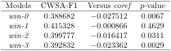
Effectiveness of Coreference Resolution
Comparing the average CWSA-F1 scores of a naïve windowing model, under different window sizes, to the performance of the coref model.
The p-values, based on the average differences, were obtained using one-tailed nonparametric bootstrap resampling with 10,000 iterations.
win-n extends the single sentence boundary of sentence to also include the n preceeding and n following sentences, while also piecing all relevant sentences of a document together to generate 1 neighborhood per document.
Notes:
Lastly, we wanted to test the importance of various NLP components to our model. As mentioned, the improvement from the event model over the coref model shows that focusing on event participants is important. We also know that using coref to expand the neighborhood area is important, but can we achieve the same result using a simple windowing method to expand the neighborhood area?
The windowing method simply extends the sentence boundary of the sentence model to include the n preceeding and n following sentences. So for win-2, we would include the 2 sentences before and 2 after each target sentence in our neighborhood. We compared the performance of coref to the windowing method with several different configurations.
Here is the average CWSA-F1 score across 26 chase videos for each window configuration.

Slide 56
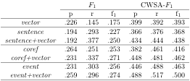
Ensemble Models
Combine a deleted interpolation model (text space) with vector model (latent space) creates an ensemble model.
Every ensemble model outperformed its respective individual components.
Information gained from operating on text and operating in the latent vector space are highly complementary.
Improvement to each will improve the resulting ensemble model.
Notes:
First we look at ensemble models.
For each deleted interpolation model, which operates on text, we combined it with the vector model, which operates in a latent conceptual space to create an ensemble model. So the combination of the sentence model and the vector model yields the sentence+vector model. And similarly for others.
We see that every single ensemble model outperformed its respective individual components, all by statistically significant margins.
-
This evidence strongly suggests that the information gained from operating on text and operating in the latent vector space are highly complementary. This means we can make improvements to each model separately, and any local improvement to the individual models will improve the resulting ensemble model.

Slide 57
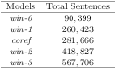
Effectiveness of Coreference Resolution
coref outperformed all tested windowing configurations.
Improvement over win-1 is not significant.
coref and win-1 generate very similar neighborhoods (extracted roughly the same number of sentences relevant to chase).
coref does not do worse + provides references to participants for downstream process.
Notes:
We see the the coref model outperformed all tested windowing configurations.
-
Except the improvement over win-1 is not significant.
Let’s think for a moment about why that is. If a piece of text is coherent and cohesive, then successive sentences are very likely to refer to the same concepts and topics. And win-1 always grabs the immediately surrounding sentences. Moreover, since newswire text tend to be short, thus win-1 is likely to generate the same neighborhood area as coref. This is reflected in this table, which shows the total number relevant sentences retrieved from the corpus by each model. We see that coref and win-1 retrieved roughly the same number of sentences relevant to chase.
-
In general, coref does not do worse than a simpler method, which is good news. This warrants the added complexity of using coref, as it also provides references to participants in each sentence for the downstream process.

Slide 58
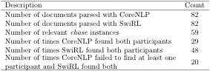
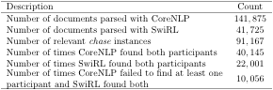
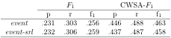
Semantic role labeling

Slide 59
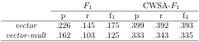
Vectors Combination Operators
Notes:
We wanted operators that are both communicative & associative, so that (chase, policeman) and (policeman, chase) map to the same vector representation.
We tested summation and multiplication.
Results are consistent with Mikolov’s work, where they found semantic relationships between words in vector space by manipulation vector offsets using addition and subtraction.

Slide 60
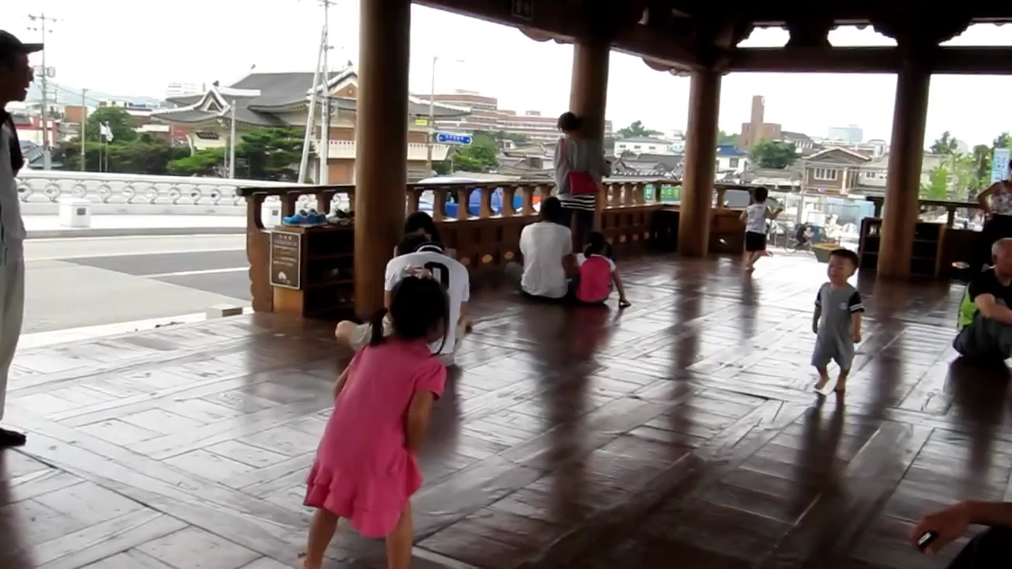
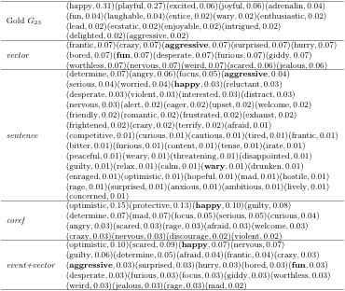
chase23
Notes:
Example output for the 23rd chase video in our dataset. Each distribution is represented as a list of elements and their associated weights. The gold standard distribution G23 is generated by aggregating mental state annotations from 10 different MTurk workers. The response distributions are given by various different neighborhood information extraction models. Bold font in a response distribution indicates an exact match with an element from G23 .

